Slide 1

Joyce Fang, Yuchen Luo, Ilhwan Song

Slide 2
Problem
Solution
An RPI student named Bob was about to graduate. He had a mini fridge that he wanted to give away, but he did not know who to sell it to. Bob thought he found the key to his dilemma when he came across the Facebook Group RPI Free & For Sale, but when he tried joining the group, he was not granted access.
RPI Free & For Sale, the website, is a way for students to buy and sell items more easily and efficiently among other RPI students.
Notes:
It includes a product listing page of all of the items being sold, an upload page where a seller can fill a form about the item they wish to sell, a login and sign up page, and product descriptions of items being sold.

Slide 3
Main Areas
Primary: Area 4, Pull real data from a database
Secondary: Area 1, HTML, CSS, and graphics for page layout and design
Notes:
Main areas we focused on include Area 4 and 1. Pulling real data from the database. HTML, CSS, and graphics for page layout and design. In addition to these areas, we worked on putting data into the database, and form validation using javascript.

Slide 4
Information Architecture
index
login
uploadform
nav.inc.php
logout
productDescription
contact
Notes:
Here is a simple diagram of the information architecture of the website. It includes the different elements of the website that link together. As seen here, the index page is linked to the uploadform, the navigation bar, and the logout.

Slide 5
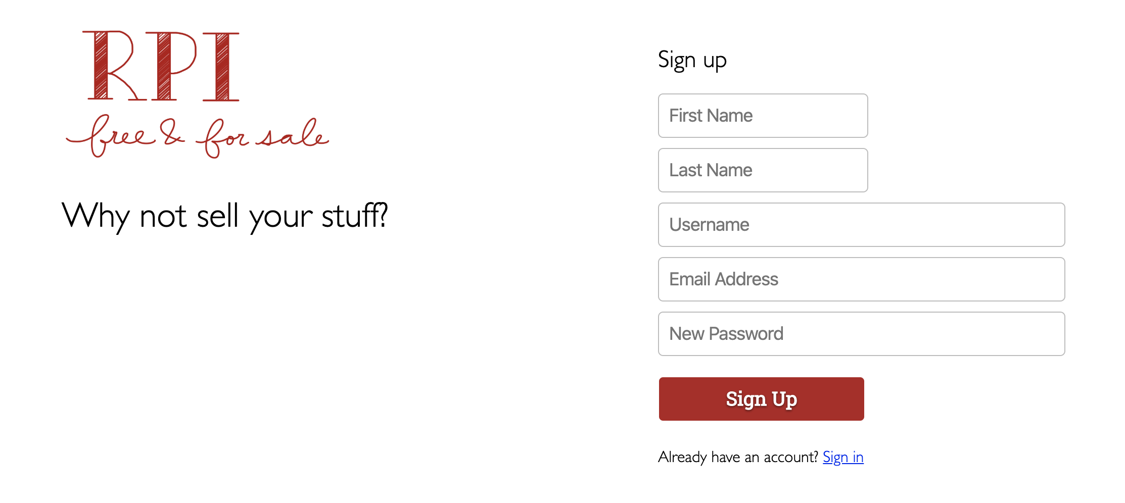
Sign Up
Notes:
Bob is a new user of the website so he puts his information in the sign up form.

Slide 6
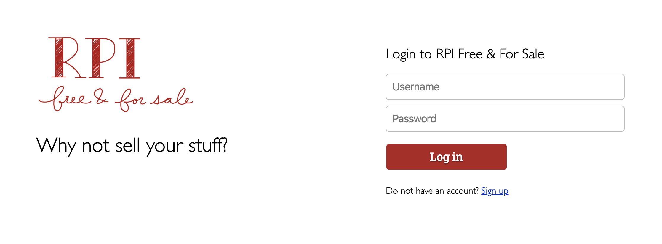
Log In
Notes:
Bob can log in with his credentials

Slide 7
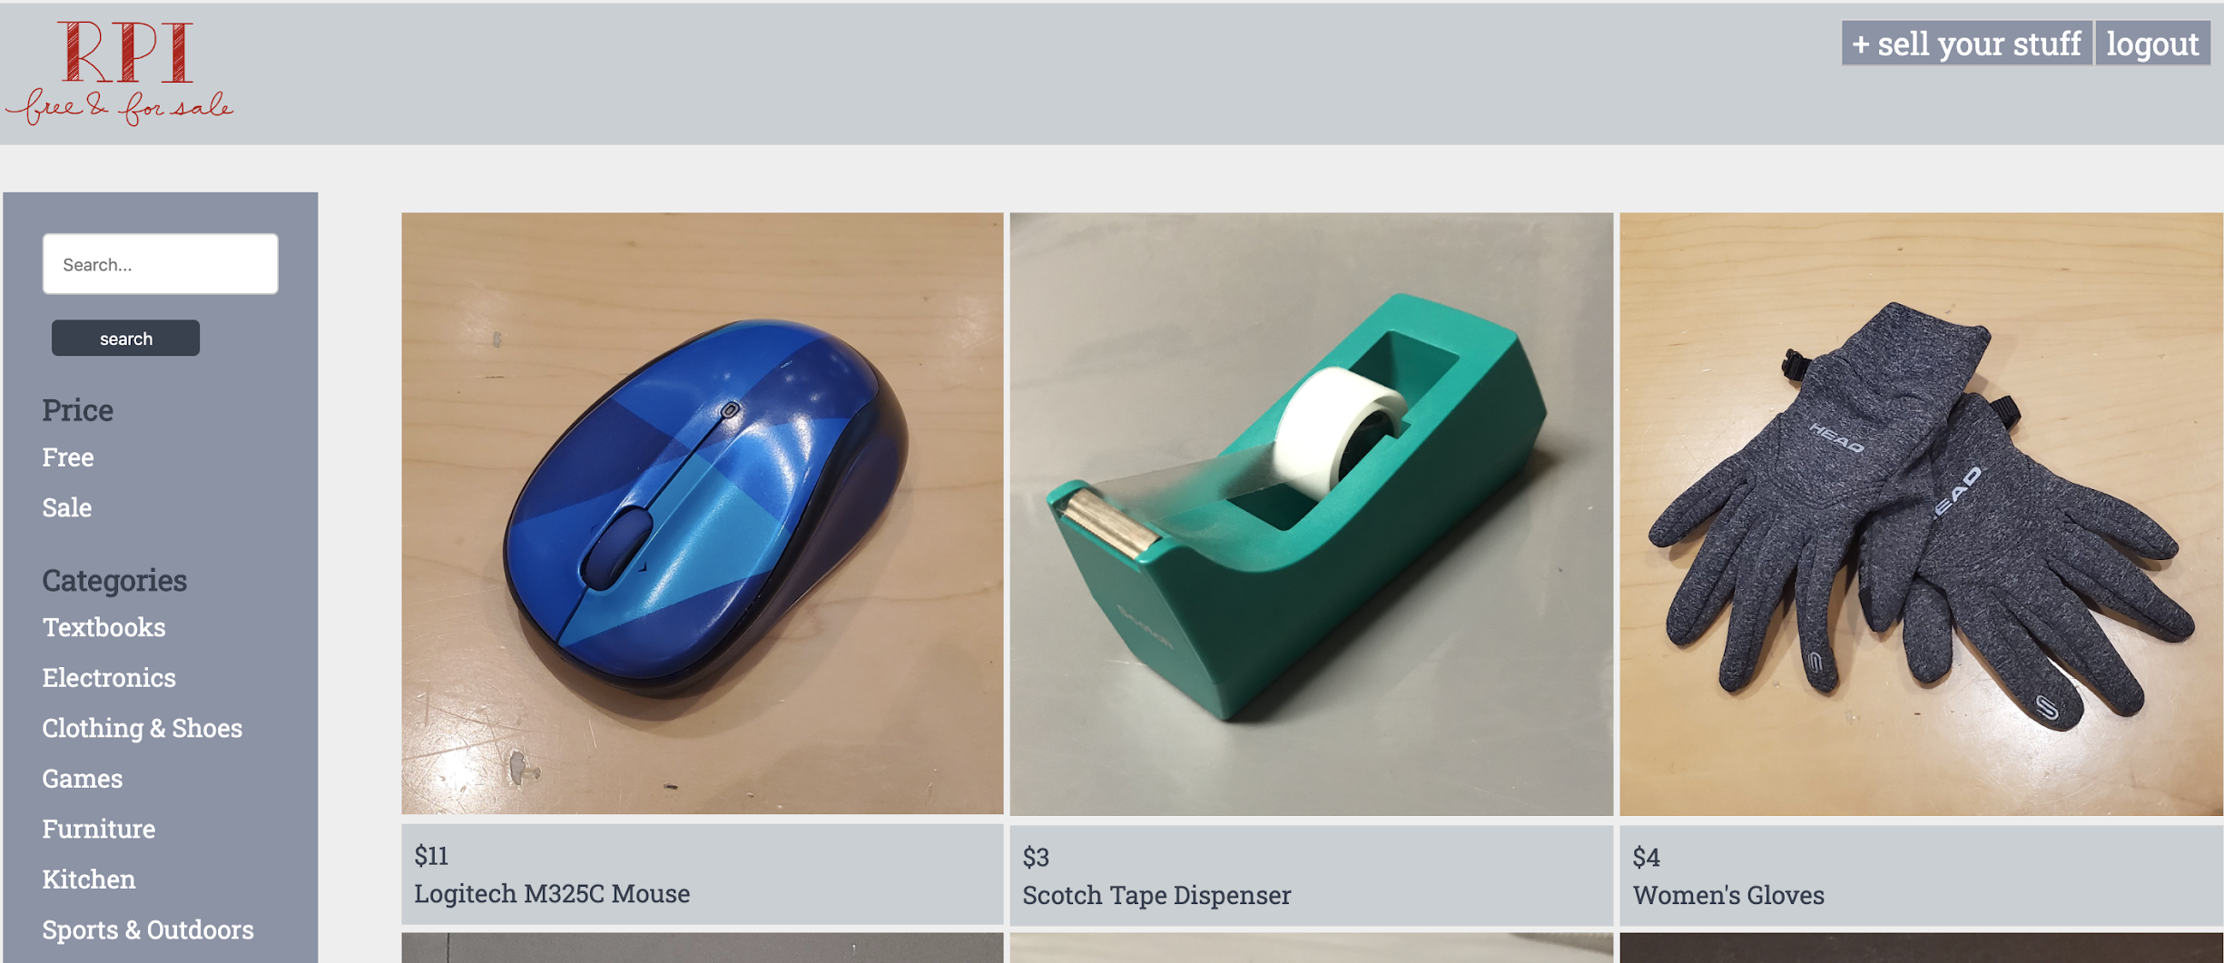
Index
Index of the website
All the products
Categories on the navigation bar
Notes:
After Bob logs in, he sees the homepage of the website where all the products are listed. There is also a navigation bar with a search bar, two price points (free and sale), and various categories ranging from textbooks to kitchen to furniture.

Slide 8
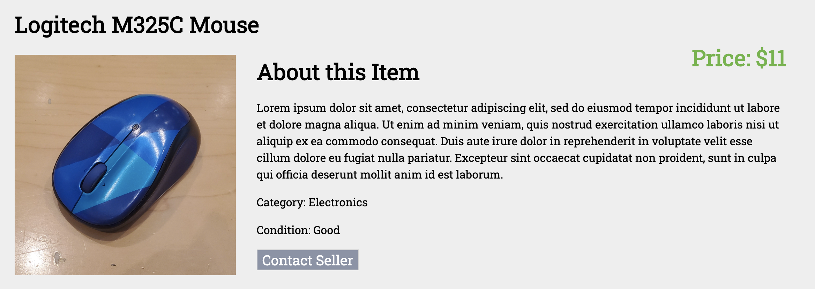
Product Description
Description of the mouse appears
Category, condition, price
Contact seller button
Notes:
Once Bob clicks the image of a product, the website directs him to a product description page where there are important details about the product. Now, since Bob finds the mouse to be interesting, he clicks on the contact seller button.

Slide 9
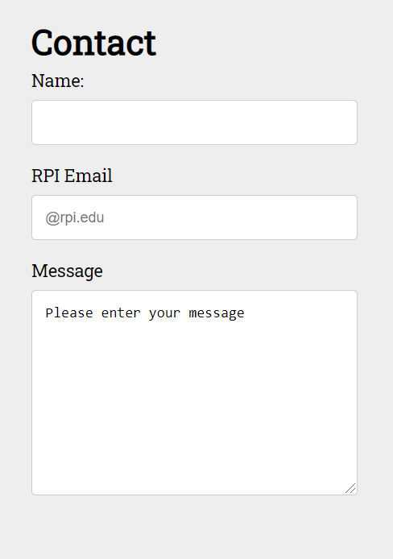
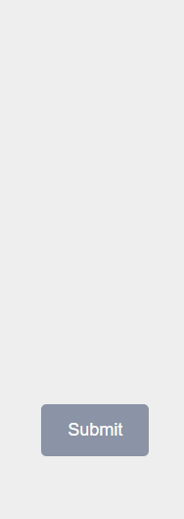
Contact Seller
Bob finds M325C Mouse interesting and clicks on the contact seller button. The website directs Bob to where he can fill out and submit a form to contact the seller and buy the mouse.
Notes:
And this form appears where Bob can fill out the form to reach out to the seller

Slide 10
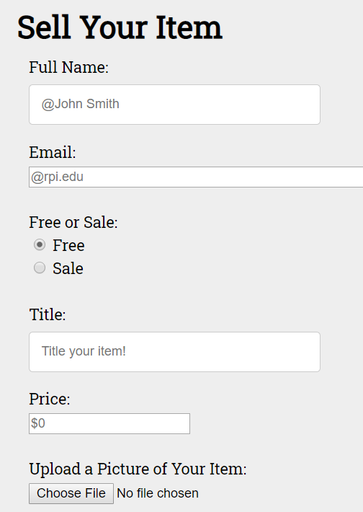
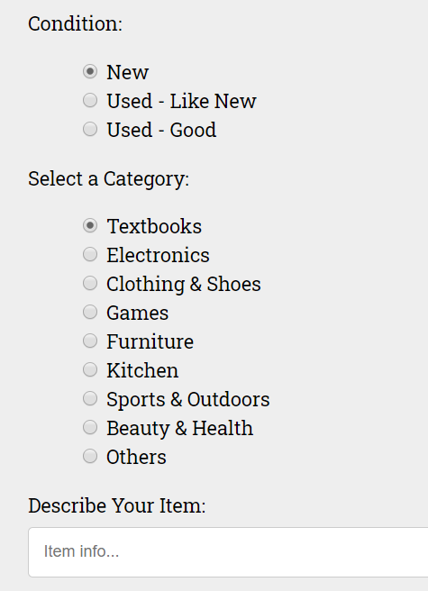
Upload Form
In order to sell the fridge, Bob clicks on “+ sell your stuff” button. Then website directs Bob to a upload form page where Bob must fill out in order to upload his item on the website.
Notes:
Now that Bob has a general idea of how the website works, he decides to sell his mini fridge. He clicks the +sell your stuff button which directs him to a form where he can describe the fridge.

Slide 11
Demonstration
How the Website Works
Notes:
Now, Yuchen will do a demonstration on the website and how it works.

Slide 12

End of the Story
Now, Bob will wait until someone finds interest in his fridge after someone reaches out to him with the contact seller form!

Slide 13
Flow of Data
User Input
User submits input and calls database
Database
Saves the user input data in the database
PHP
Reads the data from the database and display it on the website
Notes:
Here is the flow of our data. First user submits their input calling the database. Then the user input data are saved in our database. Then codes to read the data from database and display them on the webpage.

Slide 14
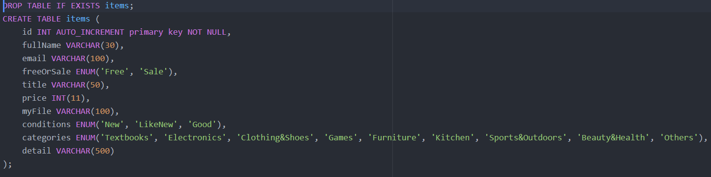
Create Table for Database
Notes:
Important ideas from this table include incrementing the id so that they are unique. And using ENUM (Enumerated Types) There are set of values and only one of them is selected.

Slide 15
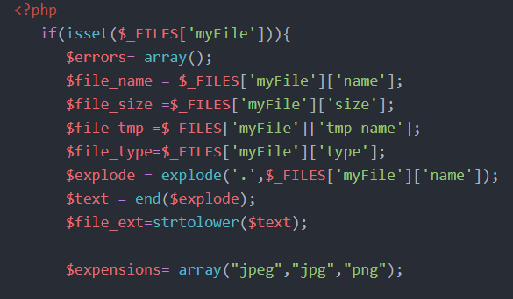
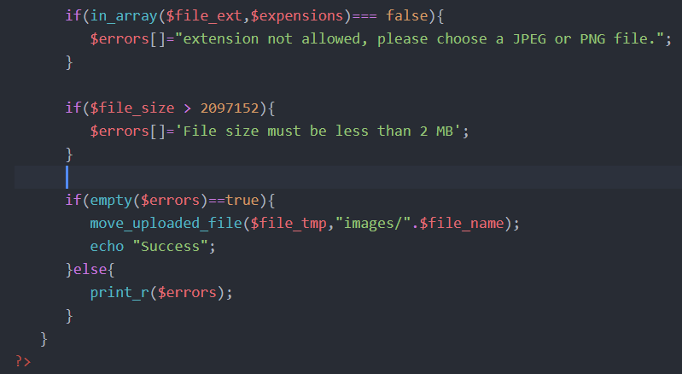
File Upload
Notes:
Here is the code to make sure that the user has inputted the correct file and checking size of the image, as well as saving the name of the file in the database and moves the file to a folder called images.

Slide 16
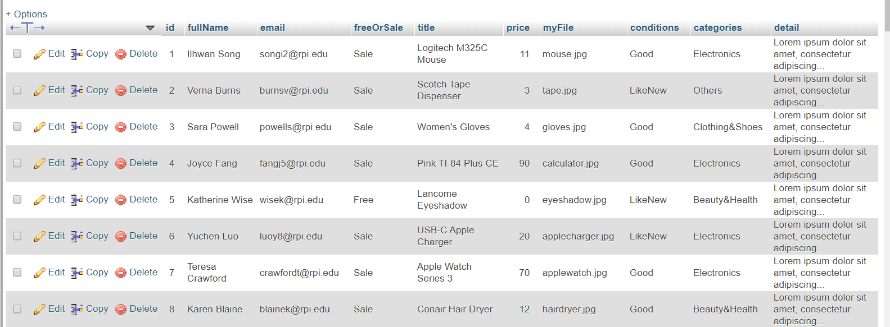
Database

Slide 17
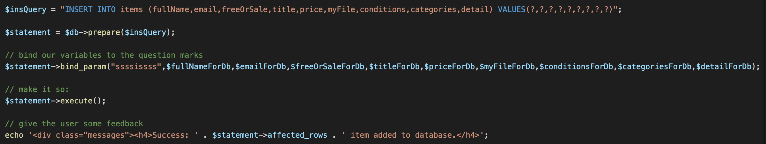
Code 1: Reading the inputs
Notes:
Here is the code for inserting the user input in the table.
It includes a prepared statement, which is essentially a template containing a placeholder instead of the actual parameter values.
The bind-param function binds the bind variables to the placeholders and tells the database what the parameters are.
The placeholders are replaced by the actual values at the time of execution of the statement.
The advantages to using this method is that it provide strong protection against SQL injection because parameter values are not put directly inside the SQL query string.

Slide 18
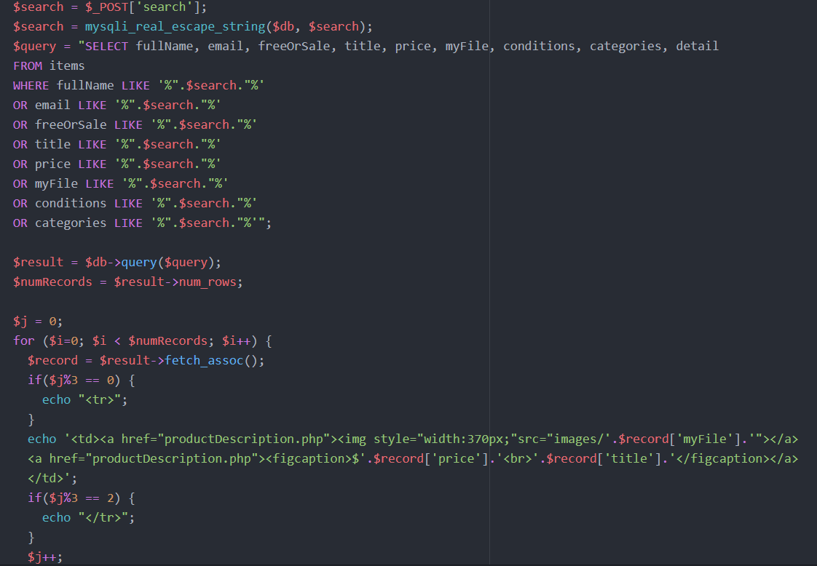
Code 2: Reading the data and displaying it

Slide 19
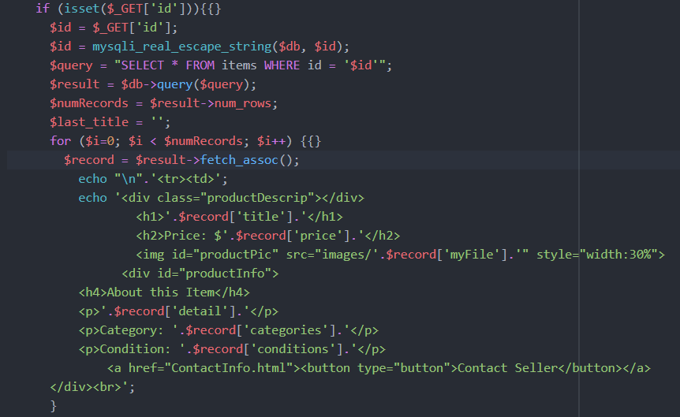
Code 3 $_Get to display Product Description php

Slide 20
Thanks for Listening!
Any Questions?

